Slide 1
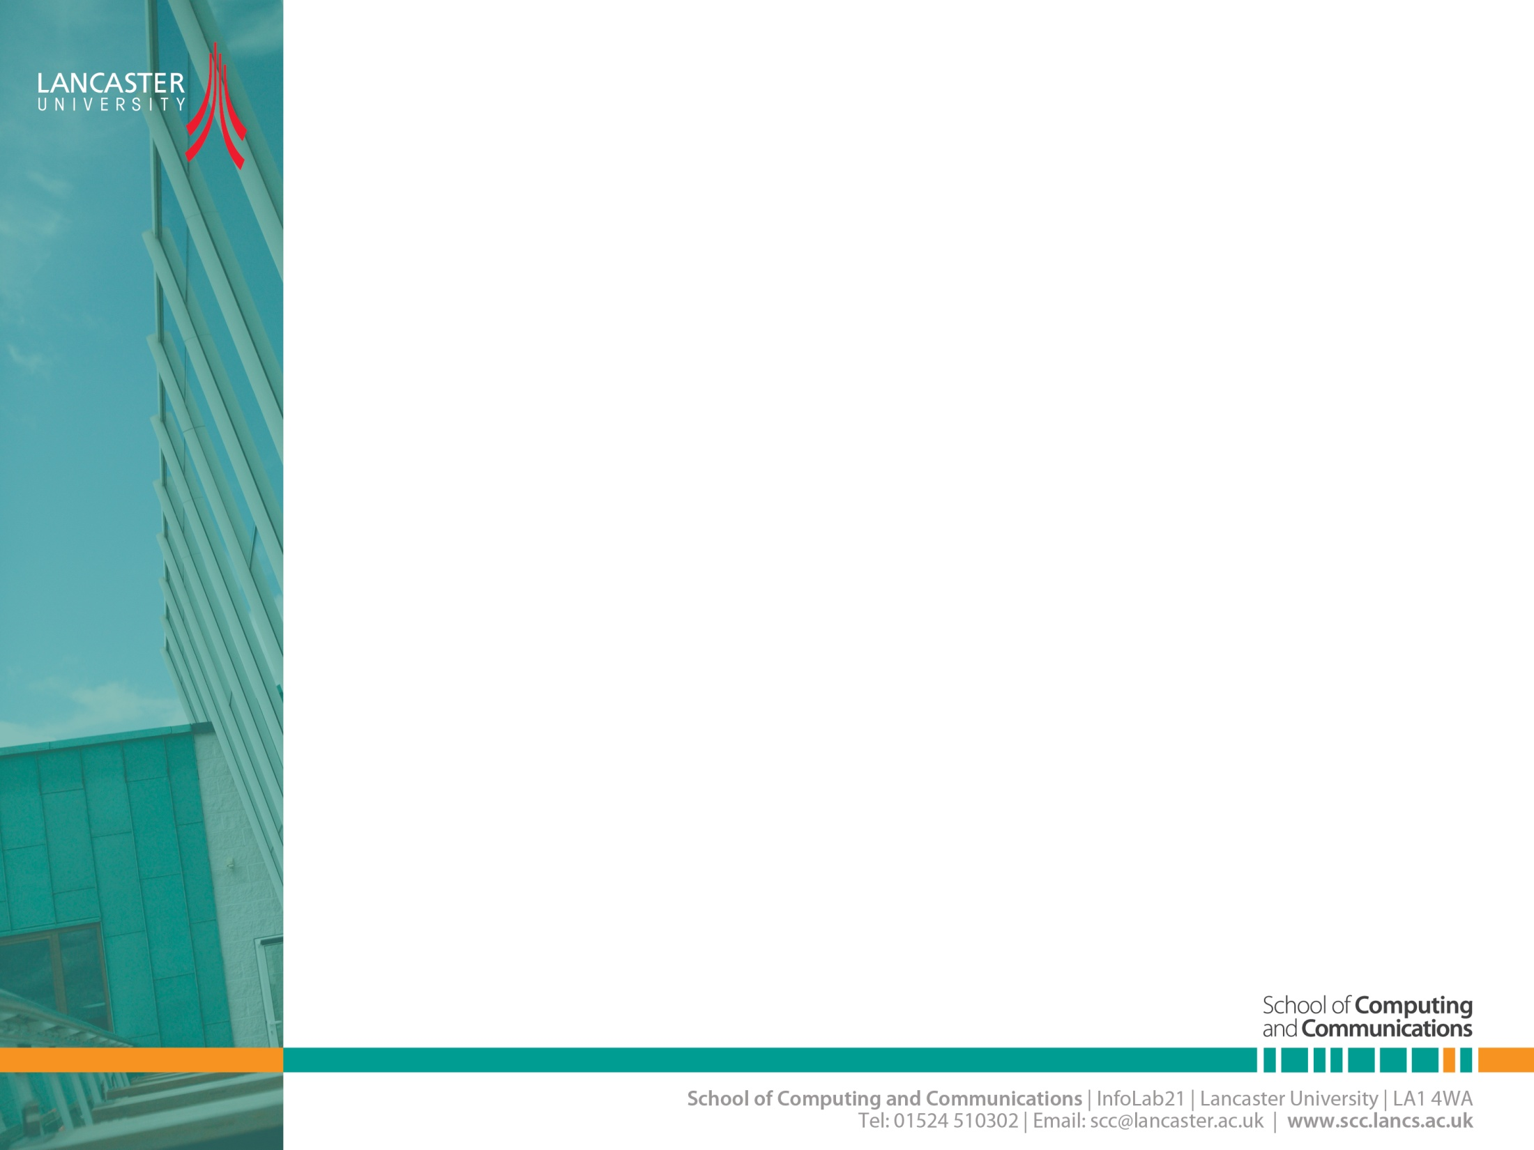

Tutorial
CNSCC.405
Digital Signal Processing
Dr Muhammad Abrar (Dr. MAB)
m.abrar@lancaster.ac.uk

Slide 2
Question 1
Explain how using antenna diversity helps wireless systems mitigate fading, and contrast this with how spatial multiplexing enhances spectral efficiency.
b) Define time diversity and frequency diversity. Provide an example of a communication technique that relies on each type.
c) A 2 × 4 MIMO system experiences an SNR of 15 dB on every receive antenna and occupies a 10 MHz bandwidth. Estimate the total data rate assuming two parallel spatial streams.
d) Using the same SNR and bandwidth, determine the capacity of a SISO link, and briefly state why the capacities differ.

Slide 3
Question 1
Explain how using antenna diversity helps wireless systems mitigate fading, and contrast this with how spatial multiplexing enhances spectral efficiency.
Antenna (spatial) diversity: transmit/receive over multiple independent fading paths so that the probability all paths are in deep fade is reduced.
This reduces fading/outage probability and improves link reliability (lower BER for same SNR).
Typical techniques: receive combining, selection combining, space-time coding.
Spatial multiplexing: use multiple transmit antennas to send different data streams simultaneously over the same time.
If the channel supports multiple independent spatial modes, this increases spectral efficiency (throughput) roughly proportional to the number of independent spatial streams.

Slide 4
Question 1
b) Define time diversity and frequency diversity..
Time diversity: spreading coded symbols across different time instants so that a single fading burst affects only part of the coded block.
Example:
Time-hopping spread spectrum (TH-SS).
Interleaved block coding
Frequency diversity: transmitting the same information over different frequency sub-bands (which fade independently).
Example:
OFDM with subcarrier interleaving or frequency hopping (Bluetooth / GSM frequency hopping); different subcarriers experience different fades, so coding/interleaving across subcarriers yields diversity.

Slide 5
Question 1
c) A 2 × 4 MIMO system experiences an SNR of 15 dB on every receive antenna and occupies a 10 MHz bandwidth. Estimate the total data rate assuming two parallel spatial streams.
MIMO- 100.56 Mbps.

Slide 6
Question 1
d) Using the same SNR and bandwidth, determine the capacity of a SISO link, and briefly state why the capacities differ.
SISO- 50.28 Mbps.
Why they differ:
Spatial multiplexing (2 streams) doubles the number of independent data streams when the channel supports them, so capacity roughly doubles compared with SISO at the same SNR per receive antenna
(assuming uncorrelated channels and sufficient richness).

Slide 7
Question 2
Describe what is meant by MIMO channel capacity and discuss the physical meaning behind this theoretical limit.
b) Explain how adding more transmit and receive antennas generally affects system throughput. Include at least two real- world constraints that may prevent these gains from being fully realized.
c) Identify three key factors that influence the achievable capacity of a multi-antenna wireless channel.
d) Discuss the diversity–multiplexing trade-off, and describe a scenario where a designer would deliberately choose: • more diversity gain, and • more multiplexing gain.

Slide 8
Question 2
Describe what is meant by MIMO channel capacity and discuss the physical meaning behind this theoretical limit.
MIMO Channel Capacity
The theoretical maximum data rate (bits/s/Hz or bits/s)
Can be achieved over a multi-antenna channel with arbitrarily small error probability, given a channel realization (or statistical description), SNR, and assumptions about channel state information and encoding/decoding.
Physically it reflects how many independent spatial degrees of freedom (independent eigenmodes) the propagation environment provides and how well the transmitter/receiver exploit them.

Slide 9
Question 2
b) Explain how adding more transmit and receive antennas generally affects system throughput. Include at least two real- world constraints that may prevent these gains from being fully realized.
Increasing numbers of transmit (Nt) and receive (Nr) antennas can increase capacity.
In rich scattering with uncorrelated channels, the number of independent spatial streams grows up to min⁡(Nt,Nr), so capacity scales roughly linearly with that (for multiplexing) under favorable SNR.
Real-world constraints preventing full gains:
Channel correlation / poor scattering:
CSI limitations / pilot overhead:
Hardware complexity and RF chains:

Slide 10
Question 2
c) Identify three key factors that influence the achievable capacity of a multi-antenna wireless channel.
SNR (Signal-to-Noise Ratio): Higher SNR → higher channel capacity.
Channel rank / spatial correlation More independent spatial paths → more spatial streams → higher capacity.
Number of antennas (Tx and Rx) More antennas → more degrees of freedom → higher potential multiplexing gain.
Bandwidth Wider bandwidth → higher total data rate.
Channel State Information (CSI) accuracy Better CSI at transmitter/receiver → optimal precoding/combining → higher efficiency.
Propagation environment Rich scattering improves rank; strong LoS or correlation reduces capacity.
Interference level Co-channel interference lowers effective SNR and capacity.
Hardware limitations RF imperfections, quantization noise, and antenna spacing reduce practical capacity.

Slide 11
Question 2
d) Discuss the diversity-multiplexing trade-off, and describe a scenario where a designer would deliberately choose: • more diversity gain, and • more multiplexing gain.
Trade-off:
Using design/processing to maximize reliability (diversity gain/lower outage/BER) often reduces the number of independent streams you send (so reduces peak throughput);
Conversely, maximizing multiplexing (sending many independent streams) increases throughput but reduces robustness to deep fading. A formal trade-off exists showing you can’t simultaneously maximize both gains.
When to choose which:
Diversity: when the link is delay-sensitive or needs very low packet-loss (control channels, critical IoT) or when SNR is low / channel is highly variable.
Multiplexing: when throughput is primary (backhaul, high-data-rate downlink) and the channel has high SNR and good spatial richness (so independent streams are supported).

Slide 12
Question 3 (Homework)
Compare time-domain interleaving and frequency-domain interleaving and give a communication standard or technology that uses each method.
b) A 5 × 5 MIMO system operating in Rayleigh fading has an SNR of 20 dB. Assuming all five spatial streams are used for multiplexing, estimate capacity in bits/s/Hz, and compare the result to an equivalent SISO channel.
c) State one real-world propagation or hardware limitation that could prevent all five spatial streams from being supported in practice.
d) Explain how Maximum Ratio Combining (MRC) enhances signal reliability at the receiver and give a condition under which Selection Combining (SC) would be a simpler and more suitable alternative.

